Slide 1

BMS Institute of Technology & Management
Department of Computer Science & Engineering
CaptionBot for Assistive Vision
Under The Guidance Of :
Dr. Satish Kumar T
Associate Professor
CSE Dept., BMSIT&M
Submitted By :
1BY17CS170 | Srinivas V
1BY17CS175 | Syed Rashid Pasha
1BY17CS187 | Vimal Kumar Sancheti
1BY17CS155 | Shawez Khan

Slide 2
Content
Abstract
Introduction
Problem Definition
Literature Survey
Technology Used
Working Principal
Design Methodology

Slide 3
Content
System Analysis
Overall Process
Functionalities
System Design
  Architectural design
  Component design
  Behavioural design
References

Slide 4
ABSTRACT
In navigating and understanding an outdoor environment, our world often requires the ability to see.
People with visual impairments are, therefore, faced with significant challenges in exploring these environments.
Deep learning has the potential to help part of the frustrations they face. In this project, we assess the effectiveness of using deep learning to assist people with visual impairments.

Slide 5
INTRODUCTION
Independent navigation and exploration of a city has long been a daunting task for visually impaired individuals. Guide dogs and canes have been the primary assistive devices used by the blind community to assist them with outdoor navigation. This challenge is when the user is navigating in an unknown environment. For this reason, they tend to remain in known environments , as they learn specific landmarks of those routes. Various assistive devices have been proposed to help people with visual impairments with the various tasks involved in this challenge, such as:
Navigation through outdoor environments, e.g., talking GPS systems .
Safe crossing at intersections, e.g., systems that employ inertial measurement sensors to provide feedback regarding heading during crossing .
Situational awareness, e.g., systems that provide information about points of interest around the user .

Slide 6
PROBLEM DEFINITION
Efficient recognition and analysis of images and creating a description on the image to exactly describe the scene/image.
We have taken up this challenge to help visually impaired people to help them know their surrounding, usually blind people don't get an idea of what's going on around them . So with the help of deep learning we are providing image to voice technology to help them to know what's going on in front of them by analyzing and captioning the image to help describe the surroundings .

Slide 7
LITERATURE SURVEY
Title | Authors | Conference and Year of Publication | Technology used | Outcome of the paper
Learning to Caption Images Through a Lifetime by Asking Questions | Tingke Shen, Amlan Kar, Sanja Fidler | IEEE, 2019 | CNN-RNN model, MSCOCO dataset. | An easier ,reliable and efficient way to recognize images .
FOSNet: An End-to-End Trainable Deep Neural Network for Scene Recognition | Hongje Seong; Junhyuk Hyun; Euntai Kim | IEEE, 2020 | FOSNet – ObjectNet (CNN) PlacesNet (CNN) | An easier, reliable, way of image recognition.

Slide 8
Title | Authors | Conference and Year of Publication | Technology used | Outcome of the paper
Turbo Learning for CaptionBot and DrawingBot | Qiuyuan Huang Pengchuan Zhang Dapeng Wu Lei Zhang | IEEE, 2020 | LSTM model for CaptionBot, COCO Dataset, CNN -ResNet-50 pre-trained on the ImageNet dataset. | Efficient techniques for captioning the images.
STA-CNN: Convolutional Spatial-Temporal Attention Learning for Action Recognition | Hao Yang , Chunfeng Yuan ,, Li Zhang, Yunda Sun, Weiming Hu and Stephen J. Maybank | IEEE,2020 | Spatial-Temporal Attentive Convolutional Neural Network (STA-CNN). | Efficient techniques used to detect action recognition in images and videos.
Image classification using Deep learning | M Manoj krishna, M Neelima , M Harshali , M Venu Gopala Rao | IEEE , 2019 | ANN , AlexNet database | Efficient techniques for image recognition.

Slide 9
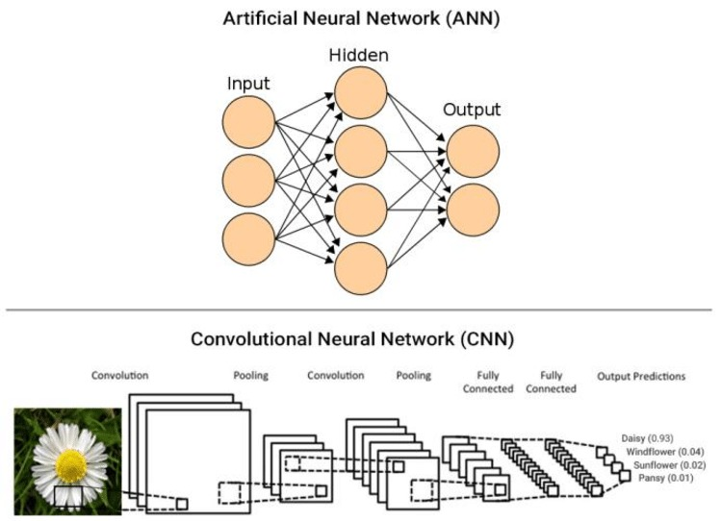
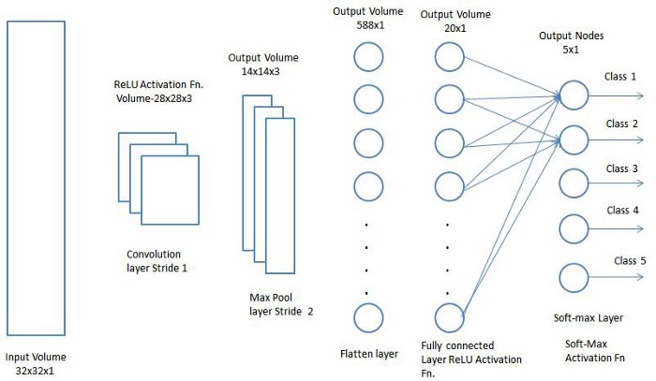
TECHNOLOGY USED
IMAGE RECOGNITION THROUGH CONVOLUTIONAL NEURAL NETWORK:
Fig.1:CNN
Figure.2:CNN architecture

Slide 10
CNN:
Step 1: Convolution layer The Kernel
The role of the ConvNet is to reduce the images into a form which is easier to process, without losing features which are critical for getting a good prediction
if input image size is 5*5 dimension and Kernel/filter dimension is 3*3
then the output i.e. convolved feature is 3*3 dimension(so we have reduced the image dimension)
Step 2: Pooling layer.
Similar to the Convolutional Layer, the Pooling layer is responsible for reducing the spatial size of the Convolved Feature. This is to decrease the computational power required to process the data through dimensionality reduction. Furthermore, it is useful for extracting dominant features which are rotational and positional invariant, thus maintaining the process of effectively training of the model.

Slide 11
Step 3: Flattening.
Now that we have converted our input image into a suitable form for our Multi-Level Perceptron, we shall flatten the image into a column vector. The flattened output is fed to a feed-forward neural network(ANN) and back propagation applied to every iteration of training.
Step 4: Full Connection.
Adding a Fully-Connected layer is a (usually) cheap way of learning non-linear combinations of the high-level features as represented by the output of the convolutional layer. The Fully-Connected layer is learning a possibly non-linear function in that space.
From the training dataset(Labelled images) our CNN will identify and learn the features of images and when a new image is given to our CNN will classify into a right category.
Once CNN classifies an image then we will convert the text (category) into voice so that the person can easily come to know what is in front of him/her.

Slide 12
WORKING PRINCIPLE
The steps for generating captions with object detection and feature extraction using neural networks are as follows.
Step 1: Object detection In this step, the objects in the input image are detected using R-CNN region proposal approach.
Step 2: Feature Extraction In this step, the features in the image are extracted using principal component analysis using NumPy. CNN is used for scene classification and RNN is used for detecting objects and human attributes.
Step 3: Creating attributes In this step, the features extracted by the neural networks were used to define the attributes with its label strings.
Step 4: Encoder and Decoder In this step, the label strings were subjected to an encoder RNN for encoding the label strings to a proper format, and the resultant variable length string is subjected to a fixed length decoder for converting to a fixed length descriptive sentence.

Slide 13
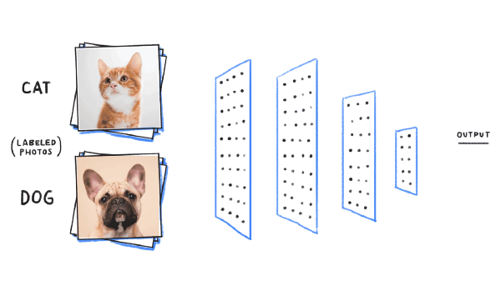

Slide 14
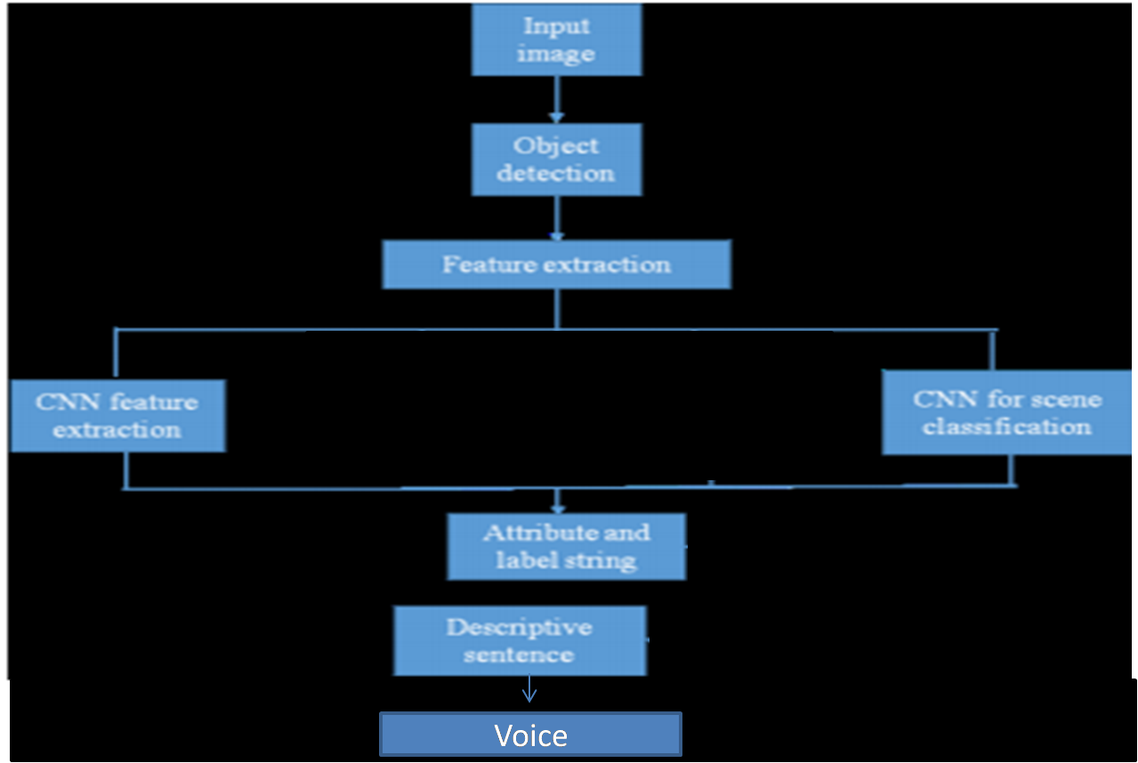
Design Methodology

Slide 15
System Analysis
GPU - Quadro 2000 (CUDA enabled, Compute capability - 2.1)
Processor - Intel® I5® CPU E5-2640 @ 2.50GHz
RAM - 6 GB
System type - 64-bit Windows 10 Education OS, x64-based processor
TensorFlow

Slide 16
Overall process
Step 1: User has to select the model and upload an image.
Step 2: Then loading of trained model will happen.
Step 3: Then the CNN model will predict/Classify the image.
Step 4: Then a descriptive sentence of an image is generated.
Step 5: Then that sentence will be converted into voice.

Slide 17
Functionalities
Object Detection capabilities
Object Feature Extraction
CNN for scene classification
Descriptive Sentence
Voice

Slide 18
System Design
Architectural design
Component design
Behavioural design

Slide 19

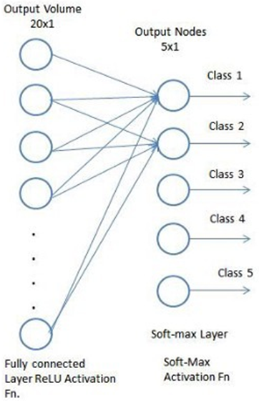
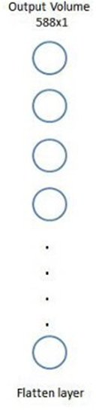
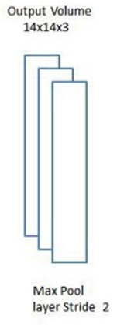
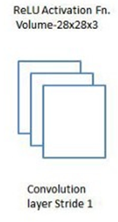
ARCHITECTURAL DESIGN
USER
Fig 1 -

Slide 20
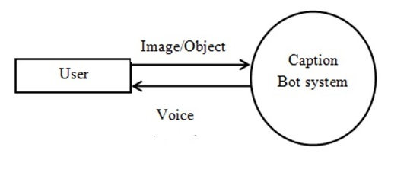
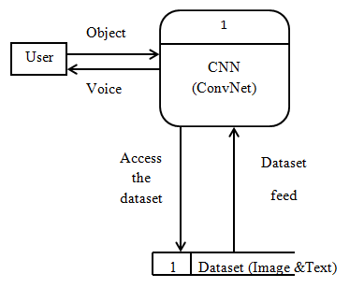
Component Design
Fig: Level 0 Data Flow
Fig: Level 1 Data Flow

Slide 21
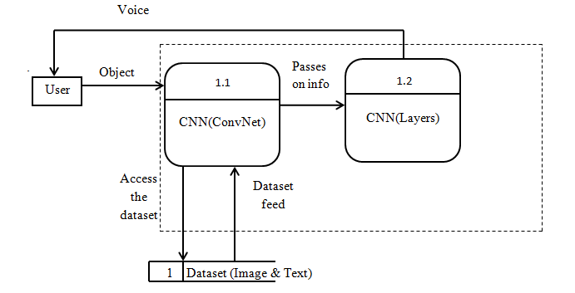
Component design

Slide 22
Behavioural design

Slide 23
Conclusion
After going through the entire process of researching, implementing and testing the developed model, it can be concluded that Convolution Neural Network Technique proves to be a very efficient method for the detection and classification of objects in real time.
the model was tested with different epoch values in order to monitor its performance at various stages. One epoch is when an entire dataset is passed forward and backward through the neural network only once. A training process may consist of more than one epoch. As the number of epochs increases, a greater number of times the weights are changed in the neural network.

Slide 24
REFERENCES
[1] L. Fei-Fei , A. Iyer , C. Koch , P. Perona. ,What do we perceive in a glance of a real-world scene? J. Vis. 7 (1) (2007) 1–29 .
[2] A. Kojima , T. Tamura , K. Fukunaga , Natural language description of human ac- tivities from video images based on concept hierarchy of actions, Int. Comput. Vis. 50 (2002) 171–184 .
[3] P. Hede , P. Moellic , J. Bourgeoys , M. Joint , C. Thomas ,Automatic generation of natural language descriptions for images, in: Proceedings of the Recherche Dinformation Assistee Par Ordinateur, 2004.
[4] J. Donahue , Y. Jia , O. Vinyals , J. Hoffman , N. Zhang , E. Tzeng , T. Darrell , DeCAF: a deep convolutional activation feature for generic visual recognition, in: Proceedings of The Thirty First International Conference on Machine Learning, 2014, pp. 647–655.
[5] A. Farhadi , M. Hejrati , M.A. Sadeghi , P. Young , C. Rashtchian , J. Hocken- maier , D. Forsyth , Every picture tells a story: Generating sentences from images, in: Proceedings of the European Conference on Computer Vision„2010, pp. 15–29.

Slide 25
THANK YOU

